Slide 1


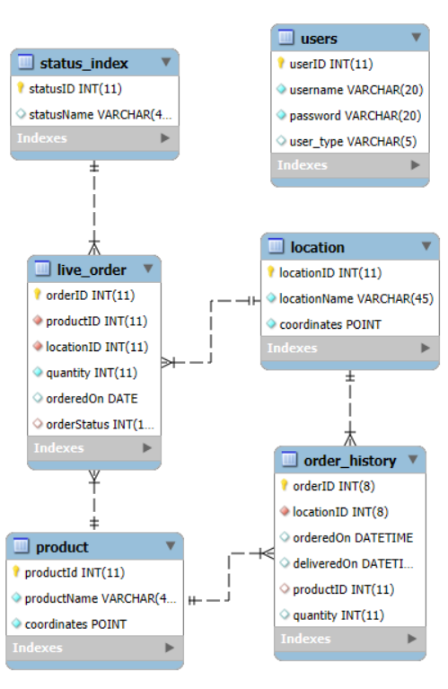
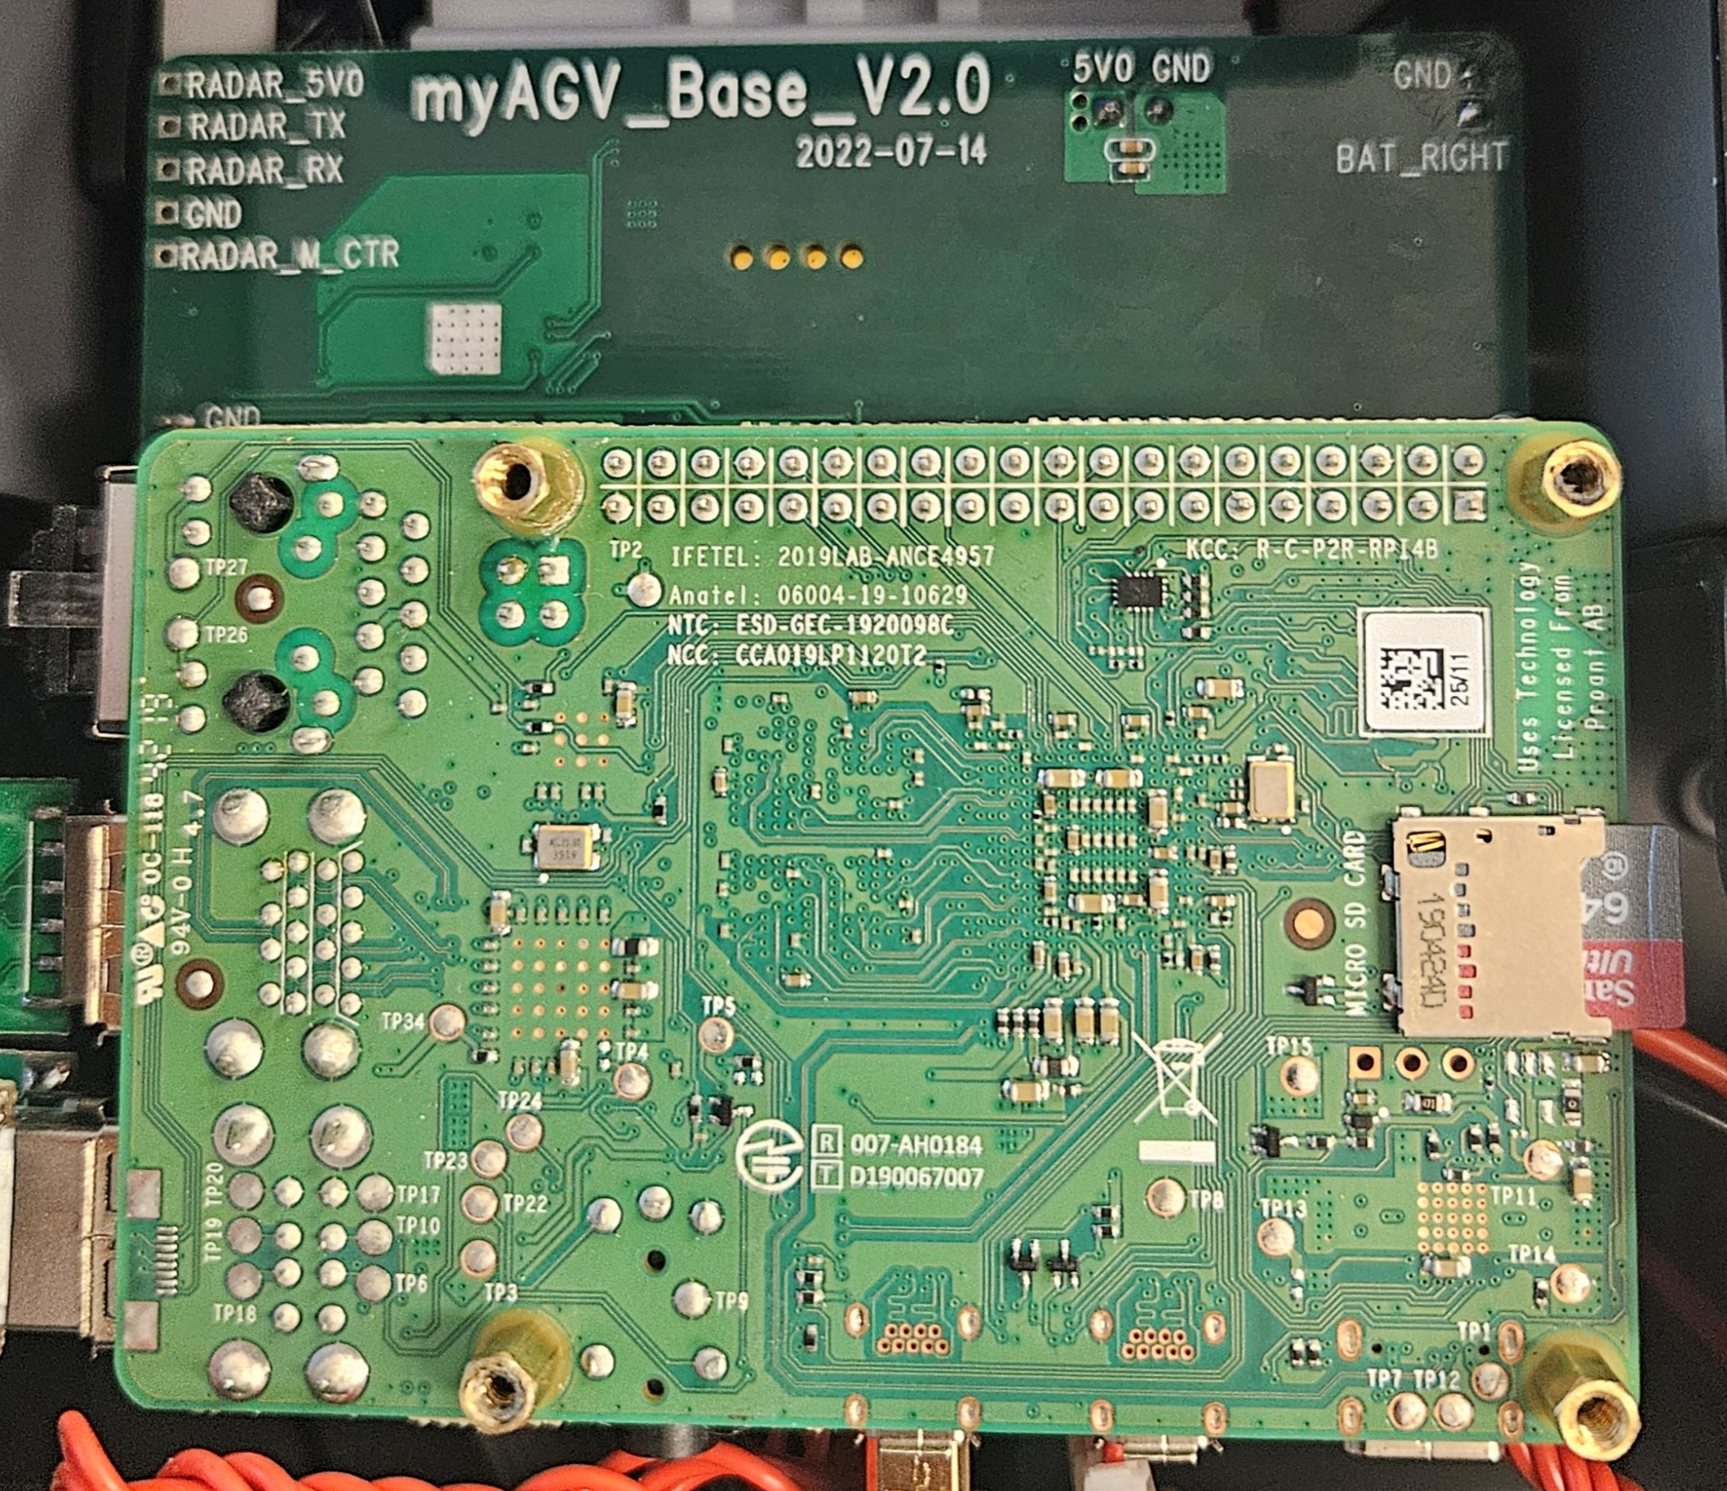
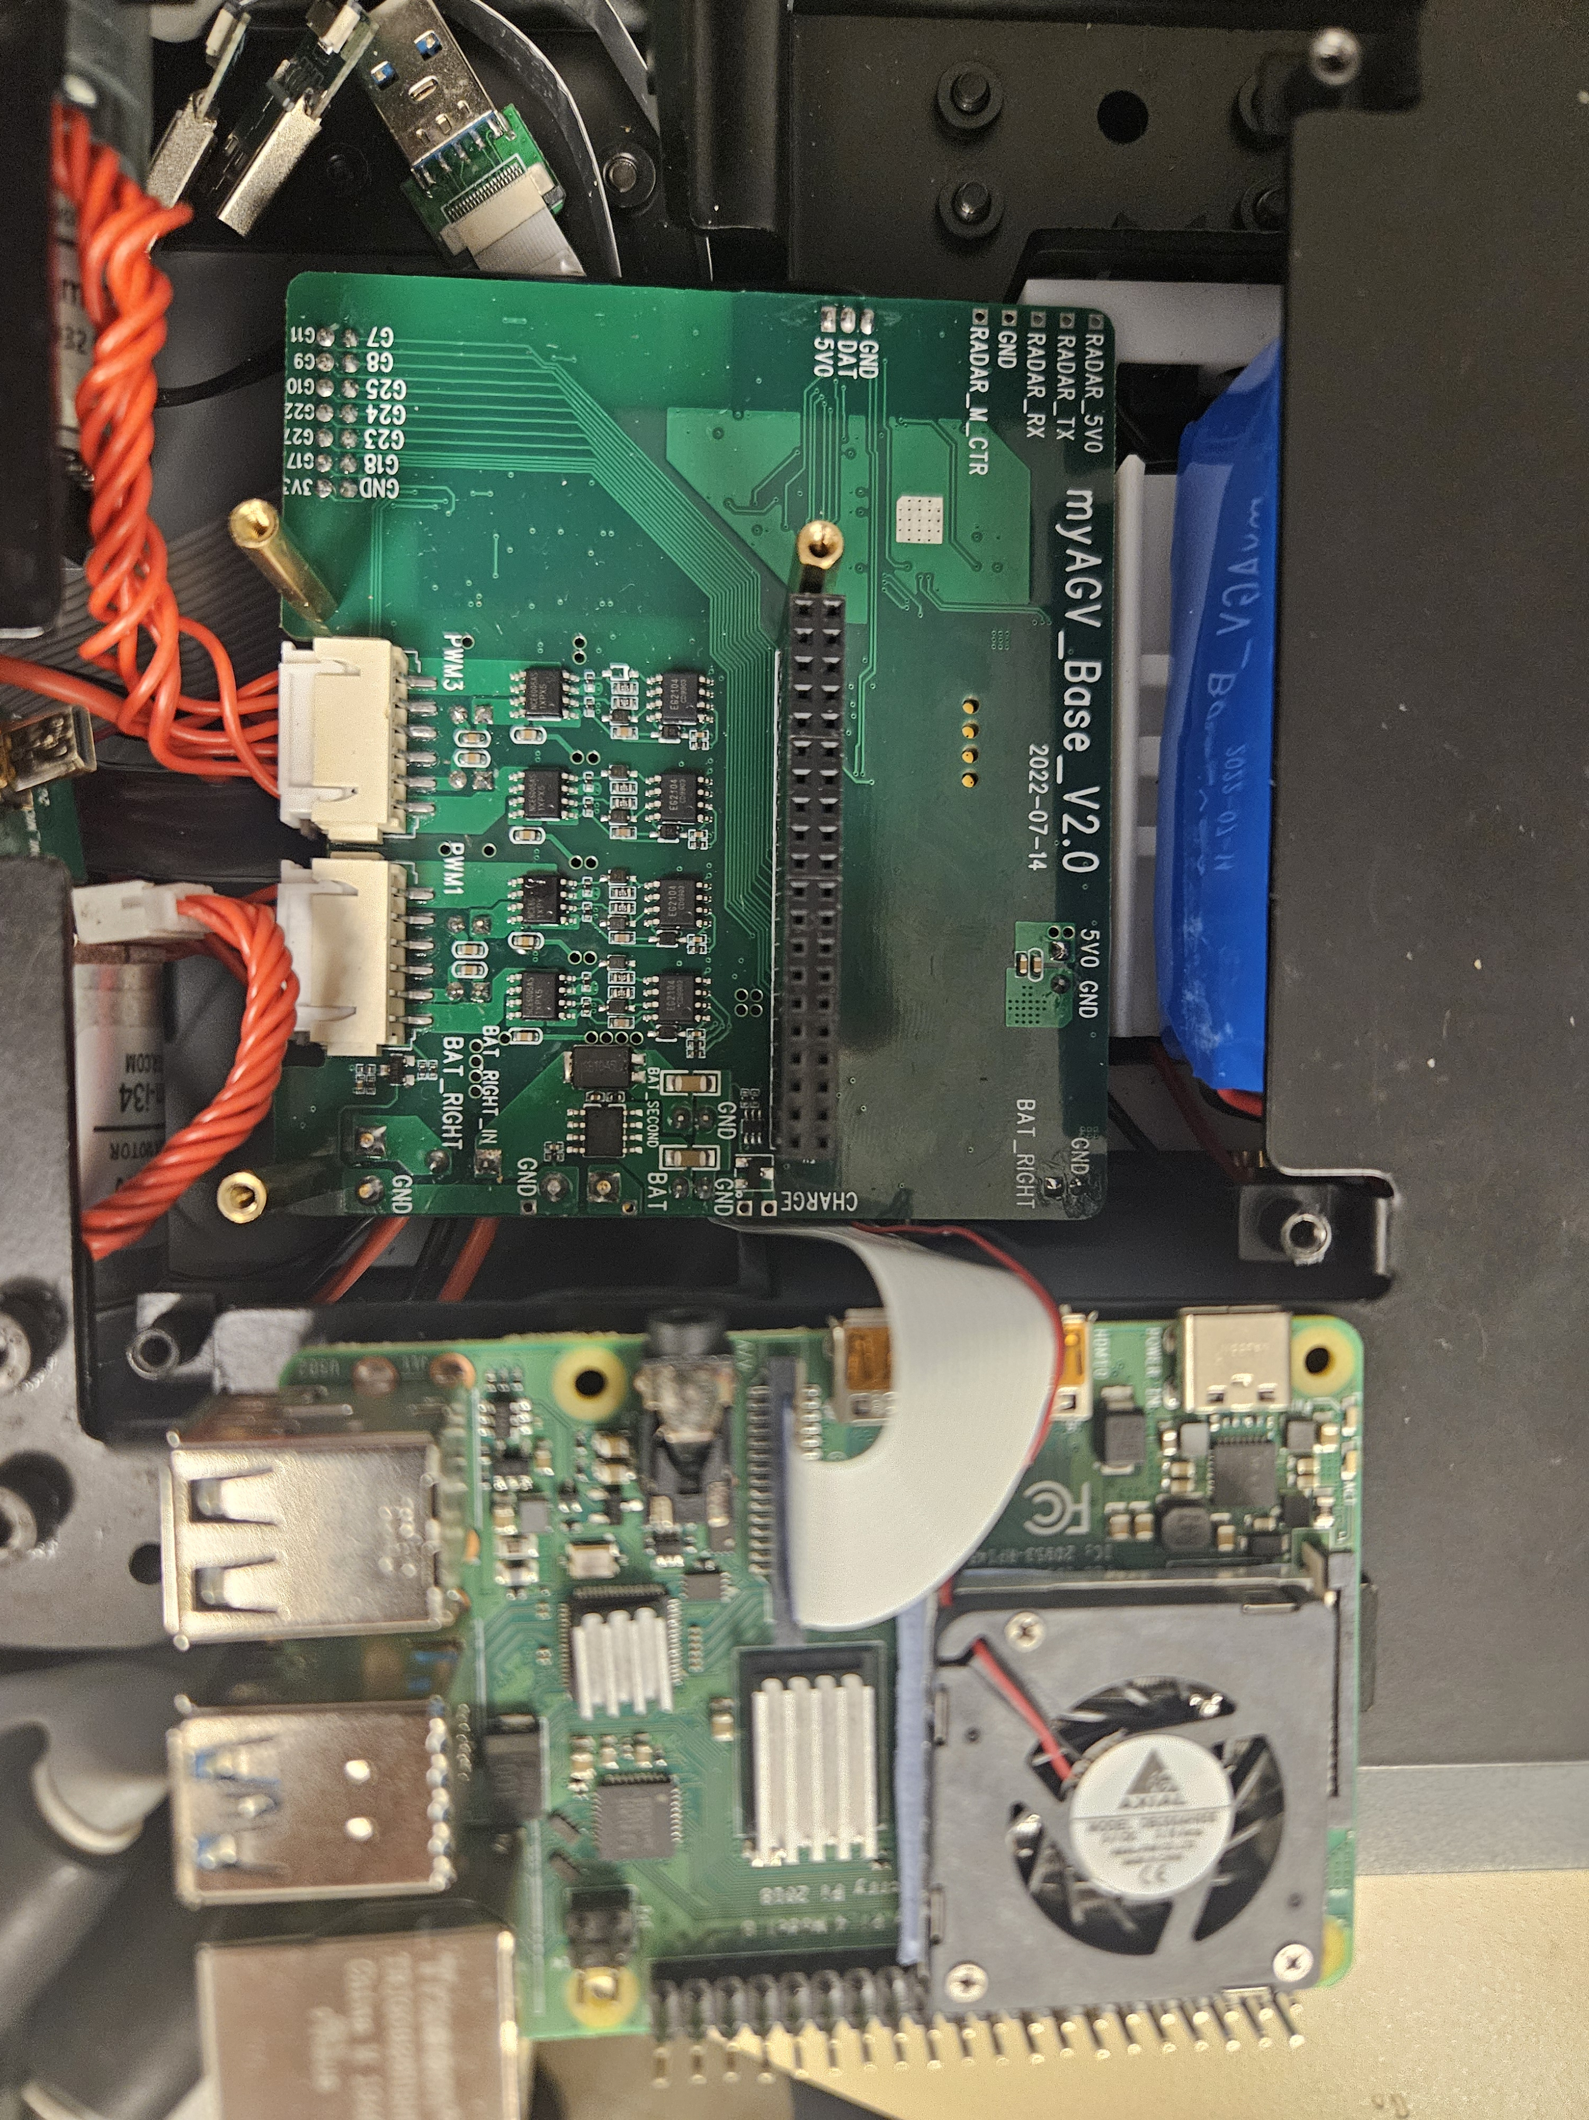
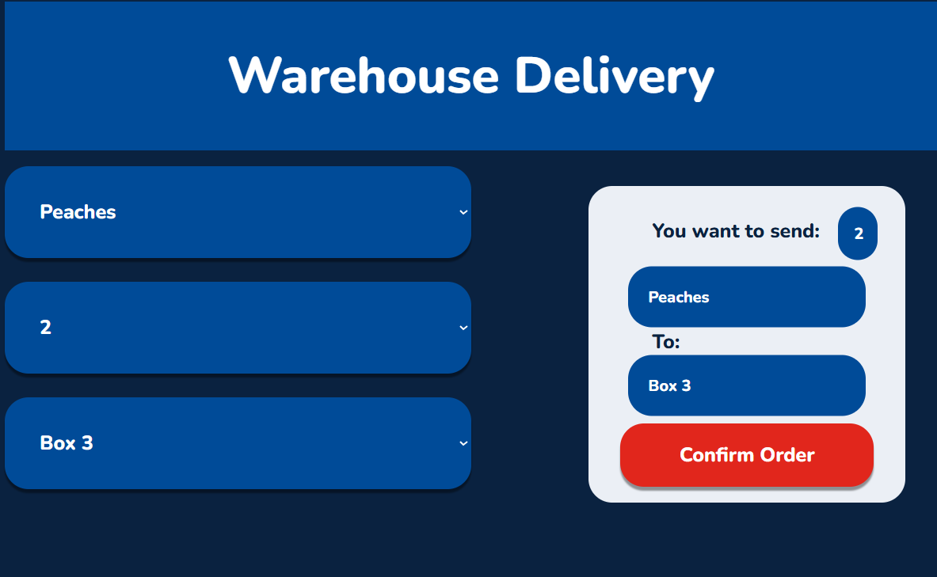
Robot Demo
James Hutchins, Leif Hoffman, Owen Yang, Vincent Liu
Professor Nancy Reddig, Dr. Sara Atwood
PURPOSE
HARDWARE
CHALLENGES
ER DIAGRAM
The Robot Demo Team had the goal of programming a robot that would remotely deliver orders to users. By using the created webpage, the robot would receive orders, pick up the delivery, and bring it to customers.
Onboard Raspberry Pi and SD card failed, forcing a swap to a new board and new software.
DESIGN SPECIFICATIONS & SYSTEM REQUIREMENTS
Robot must be able to identify products visually
Robot must autonomously navigate its environment
Robot must be automatically dispatched to fulfill orders
Users must be able to place orders
Orders must be assigned to a user
Order must be able to be tracked
Robot motor driver failed, causing front left wheel to be unable to drive forwards.
IMPACT
Created a software framework for future teams to continue the project. Identified robot hardware problems for repair or replacement.
ONLINE FEATURES
Online ordering portal
User login system
Order tracking by unique ID
ROBOT FEATURES
Product recognition by QR code
Live scanning of database for orders
Automatic removal of orders from queue
LESSONS LEARNED
While working with software, we learned how to use Git/GitHub to effectively share code between team members and use databases to store information as well as make remote contact. We also gained hardware debugging skills, having to track down the cause of the front left wheel’s faulty motion.
REFERENCES & ACKNOWLEDGEMENTS
We would like to acknowledge and thank the people who helped throughout the project. Thank you to Professor Nancy Reddig, who gave us permission to work with the robot, as well as Dr. Sara Atwood and ITS.
Software Engineering Project 2024
EDUCATE FOR SERVICE. ENGINEER FOR SOCIETY.
Notes:
Introduction. Include the student name, company name, internship location, internship position, and internship dates. Also note the course rubric and number, course title, and instructor(s). In addition, describe how you secured the internship.
Abstract. The abstract should provide a concise summary of what was done and learned in the internship and the course.
Learning Objectives. List 2 to 5 learning objectives that you had planned to achieve by completing the internship.
Description of Key Responsibilities. Summarize the major responsibilities, activities, and project(s) completed during the internship.
Application of VWU courses to the internship. Explain how your coursework helped with the internship. Link relevant courses, theories, and concepts to their applications within the internship.
Lessons Learned. Explain what you learned about the industry, the company, the career process, and yourself through the internship experience.
Acknowledgements. Recognize the people who helped you, including the internship site supervisor, the course instructor, and mentors. Include full titles in the acknowledgements. In addition, acknowledge funding sources.
Visuals. Incorporate visual aids to illustrate key points. Be sure to label all visuals. Include: names, dates, locations, and photographers. Do not include photographs of children unless you have secured approval from your site supervisor to use the children’s images.

